Slide 1
CCCM Cluster in South Sudan
Donor-partner meeting | 5 July 2017

Slide 2
Membership
Cluster Lead Agencies: IOM, UNHCR
NGO Co-Lead: ACTED
Active members:
DRC Internews HealthLink
ACTED REACH IOM

Slide 3
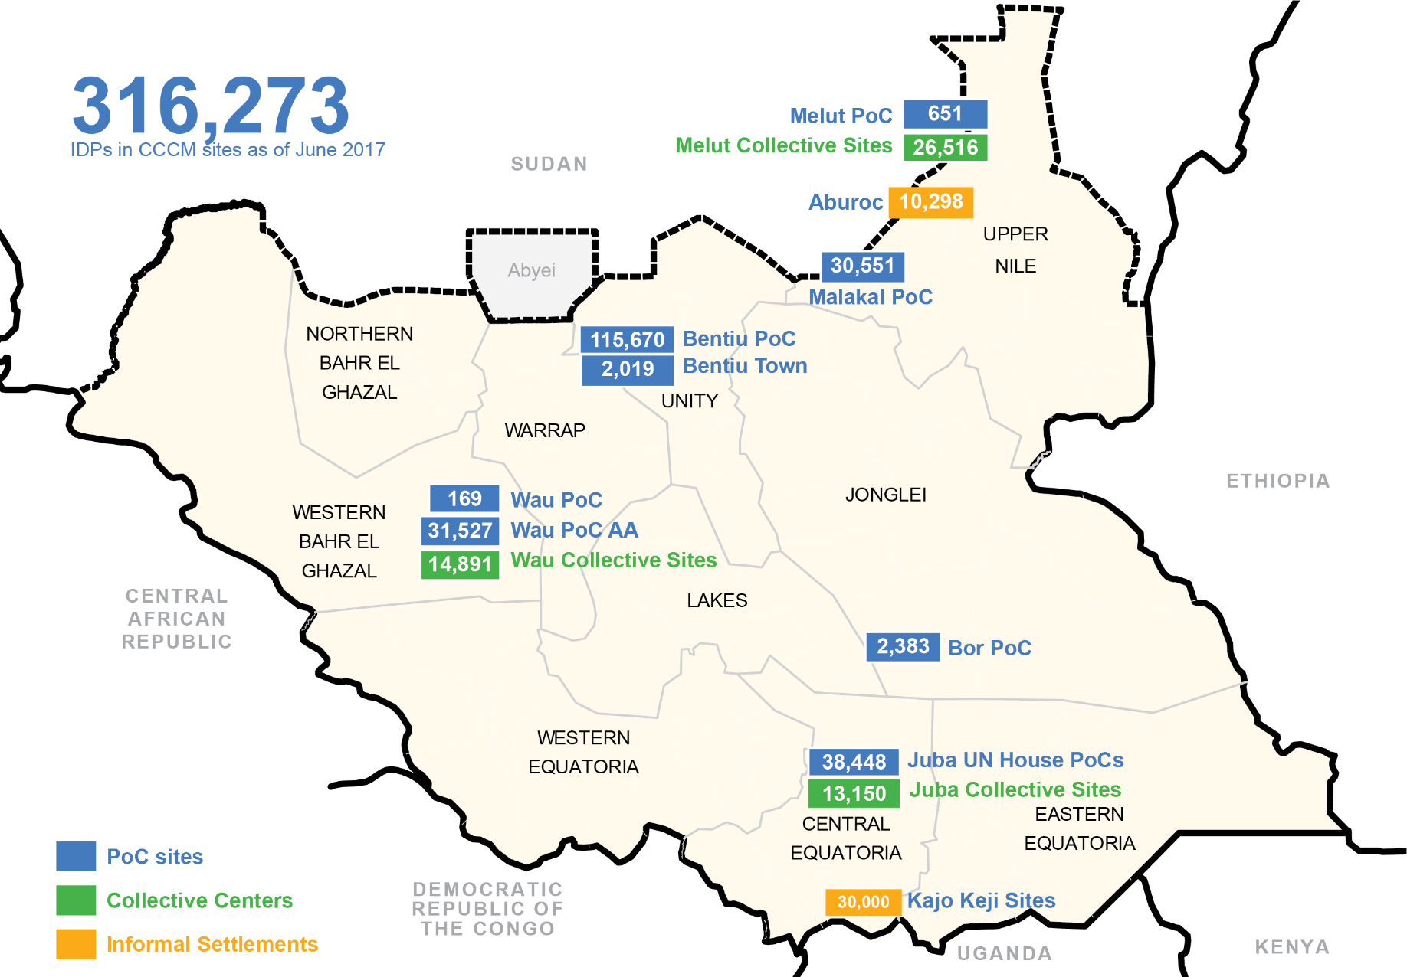
Current operational presence
Notes:
Jane: Overview of different CCCM response & sites in SSD
Agencies to update on key issues per site

Slide 4
2017 Response Strategy
Maintain operational presence in locations where IDP still decide to remain in camps/camp like settings
Build national capacities of NNGOs and Civil Society Organizations like churches

Slide 5
Cluster priorities
Expansion of CCCM methodologies
NNGO engagement
Contingency planning
Advocacy
Information management
GBV & MHPSS mainstreaming
Investment in training & capacity-building
CwC & improving AAP

Slide 6
Where are we going?
Increasing insecurity & increasing displacements → CCCM creative approach:
Build capacity of traditional front liners to carry out CCCM – trainings/mentorship/funding
Integrate GBV in all CCCM interventions – prevention and mitigation
Advocacy for protective environment/safe zones
Protracted displacement – medium-term planning for POC sites

Slide 7
What is needed to support this?
Continued support to CCCM partners
Direct/pass-through support for NNGOs/Civil Society Organizations & innovative approaches
Continued advocacy
UNMISS/Humanitarian responsibilities inside PoCs (Bentiu Berm)
Registration in PoCs
Discussion space on longer-term planning – POC living conditions in protracted crisis
Notes:
Add donors to advocacy
Registration as a single issue – not two ? Any “issues” outside of the POC sites?

